Slide 1

Comment Quality and Consistency Checker
Enhancing Code Documentation Using LLM’s Presenter: Daniel Chandler

Slide 2
The Importance of Code Comments
Code comments enhance readability and maintainability.
Clear comments facilitate collaboration among developers.
Poor commenting practices lead to misunderstandings and bugs.

Slide 3
Challenges in Comment Quality
Inconsistent and unclear comments are common.
Traditional tools focus on code syntax, not comments.
Lack of automated solutions for evaluating comment quality.

Slide 4
Introducing the Comment Quality Checker
A tool that assesses code comments using LLMs.
Evaluates comments on clarity, relevance, and consistency.
Provides actionable feedback for improvement.

Slide 5
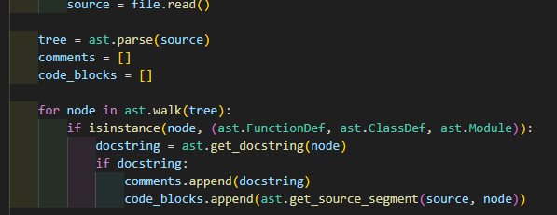
Code Parsing and Comment Extraction
Used Python's ast module for parsing.
Extracts docstrings and inline comments.
Associates comments with their code blocks.

Slide 6
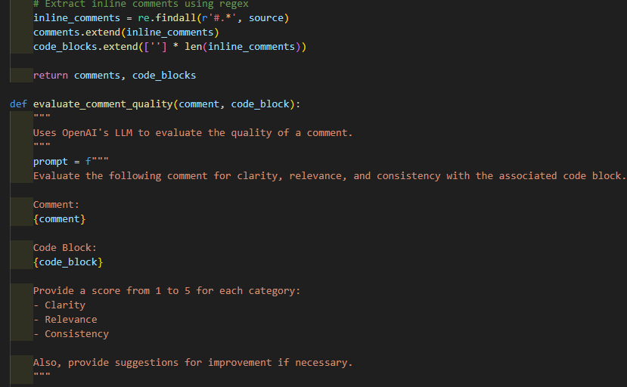
Leveraging Large Language Models
Integrated with OpenAI's GPT-4.
Constructs prompts for comment evaluation.
Parses LLM responses for scores and suggestions.

Slide 7
Assessing Comment Quality
Clarity: How understandable is the comment?
Relevance: Does it accurately describe the code?
Consistency: Is the commenting style uniform?

Slide 8
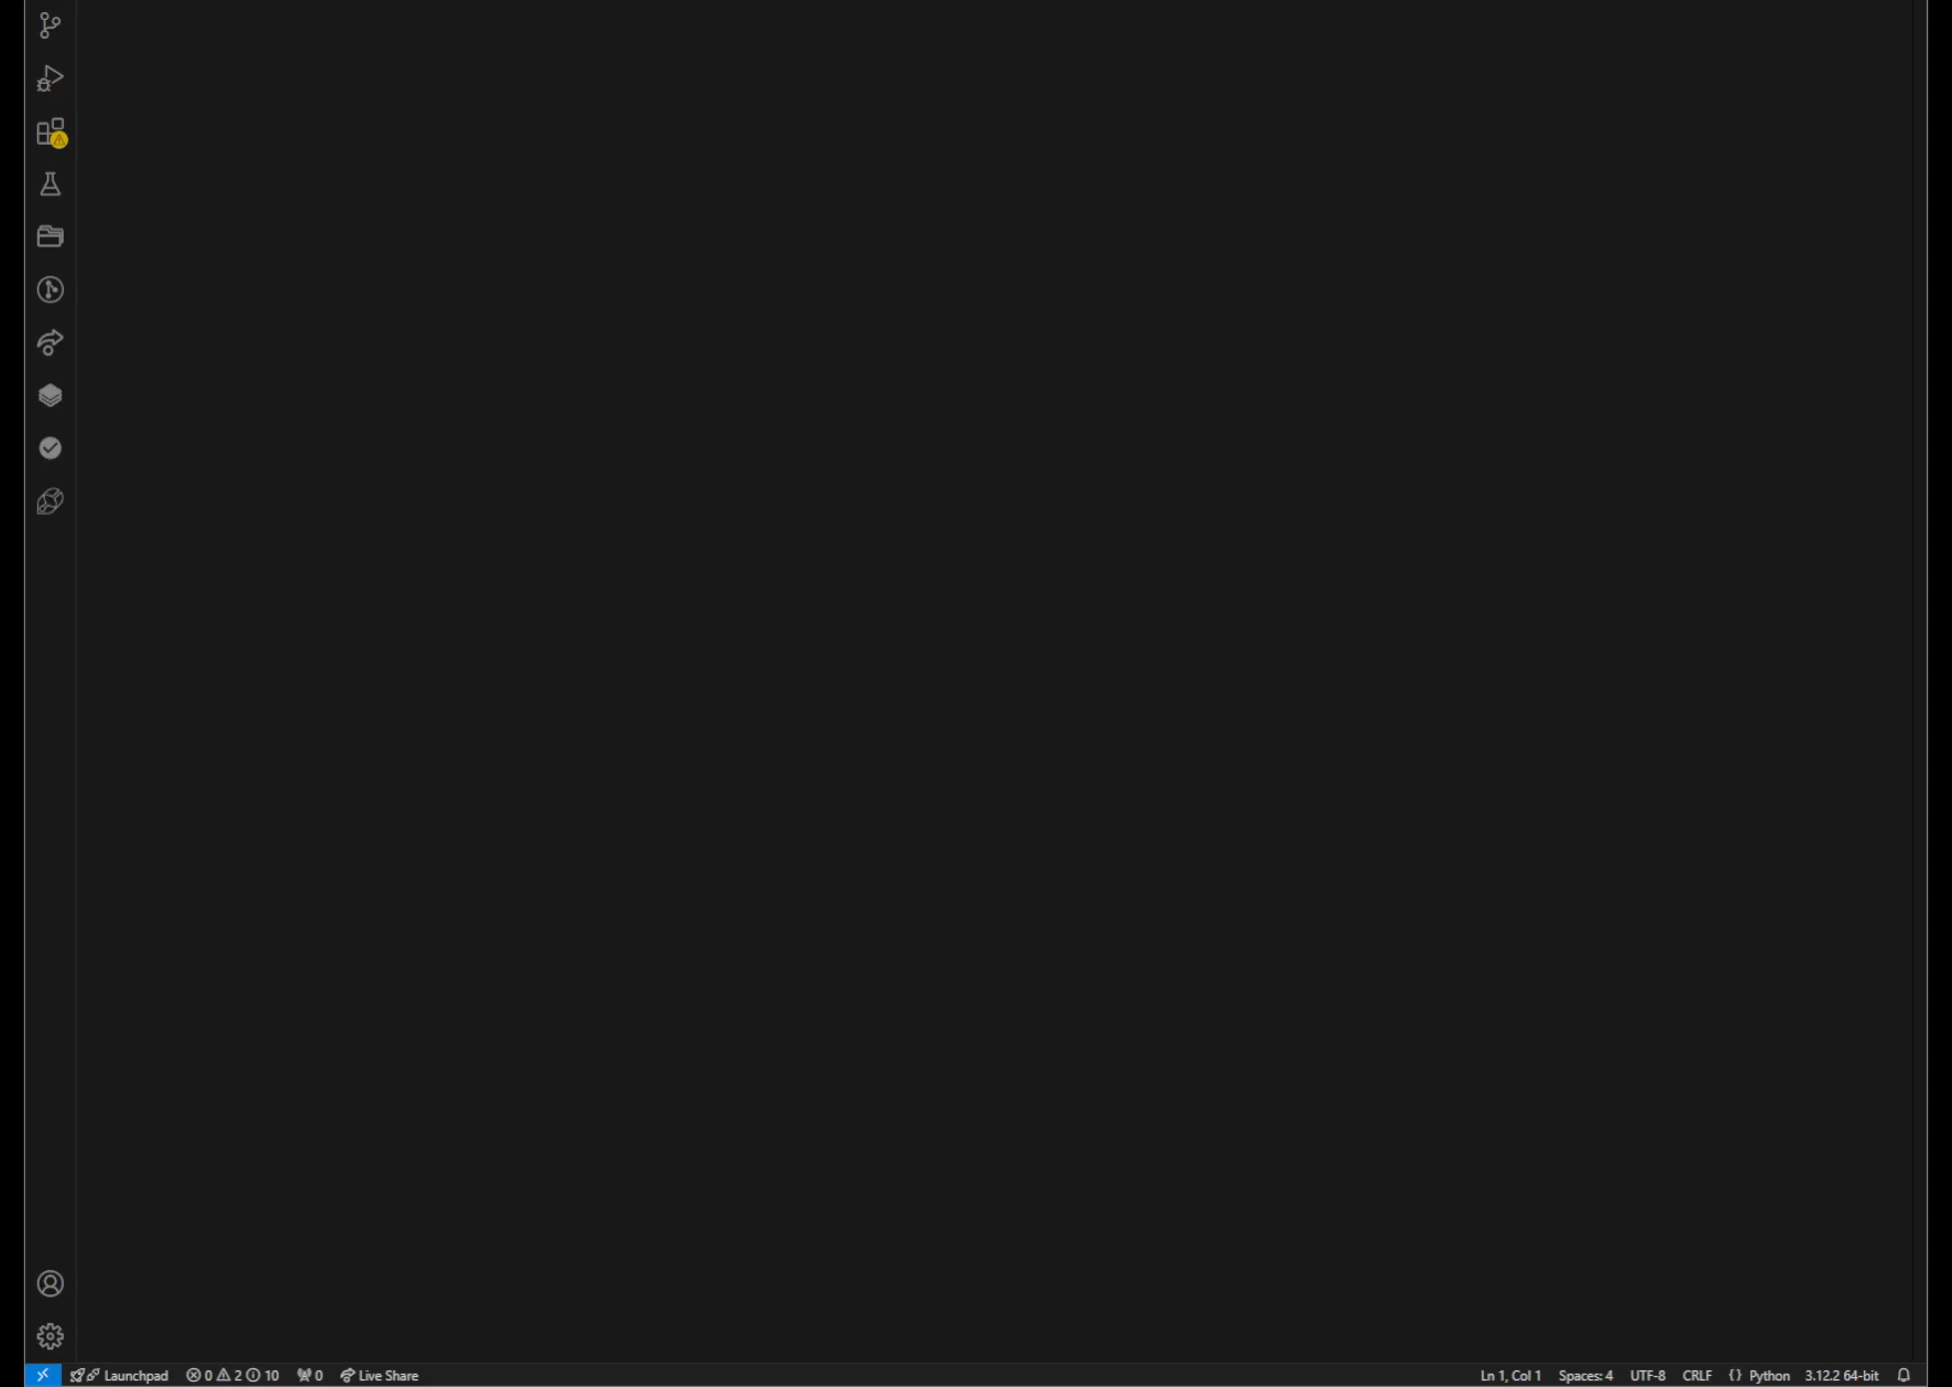
Example Results
Here are the results of the Comment Quality Checker when run on a simple program

